Slide 1
OPER 623 – Overviews: Heuristic Methods and Complexity
Lesson 5
Construction Heuristics

Slide 2
Outline
Traveling Salesman Problem (TSP)
Construction Heuristics Overview
Examples of Construction Heuristics
Nearest Neighbor
Cheapest Insertion
Farthest Insertion
Greedy for TSP
Minimum Spanning Tree - Greedy Algorithm
MST for TSP - Greedy Heuristic
Christofides Algorithm

Slide 3
Outline
Traveling Salesman Problem (TSP)
Construction Heuristics Overview
Examples of Construction Heuristics
Nearest Neighbor
Cheapest Insertion
Farthest Insertion
Greedy for TSP
Minimum Spanning Tree - Greedy Algorithm
MST for TSP - Greedy Heuristic
Christofides Algorithm

Slide 4
Traveling Salesman Problem
Traveling Salesman Problem often just called TSP
Given:
A set of vertices (representing cities, countries, circuits, etc)
Edge distances between vertices
Find the shortest path starting from any vertex, visiting all the other vertices and returning to the original vertex – This is called a tour
A known NP-Hard problem
Complications:
Non-symmetric distances
Vertex coordinates provided and distances need to be calculated
Distances could be non-euclidean

Slide 5
Outline
Traveling Salesman Problem (TSP)
Construction Heuristics Overview
Examples of Construction Heuristics
Nearest Neighbor
Cheapest Insertion
Farthest Insertion
Greedy for TSP
Minimum Spanning Tree - Greedy Algorithm
MST for TSP - Greedy Heuristic
Christodes Algorithm

Slide 6
Construction Heuristics
With a construction heuristic, you start with the null set and a solution to the problem is iteratively created.
Generally, once an element is added to solution it stays in solution.
Generally, construction heuristics build a feasible solution.
Deterministic in nature, traditionally greedy.
Construction heuristics are one of the foundational elements of more advanced modern Meta-Heuristics (Meta-Heuristics combine multiple foundational heuristic elements)

Slide 7

Construction Heuristics
Two rules uniquely define a constructive heuristic:
The definition of a move
A move $σ$is a simple operation (addition of an element, exchange of elements, etc.)
The current state of solution x, and move choice $σ$ uniquely define the set of possible next solution states $N(x, σ)$ you can choose from. These are called neighbors.
There may be a combinatorial or infinite number of feasible solutions which you can get to from you are
The evaluation choice
Out of the set of neighbors, which one will you choose?

Slide 8
Outline
Traveling Salesman Problem (TSP)
Construction Heuristics Overview
Examples of Construction Heuristics
Nearest Neighbor
Cheapest Insertion
Farthest Insertion
Greedy for TSP
Minimum Spanning Tree - Greedy Algorithm
MST for TSP - Greedy Heuristic
Christofides Algorithm

Slide 9
Nearest Neighbor Heuristic
Summary:
In the TSP, start from any city.
Move to the nearest city not currently in the tour.
Once all cities have been visited, return to the starting city.

Slide 10
Nearest Neighbor Heuristic
What are your neighbors?
At each step of the heuristic the neighbors are the set of all arcs incident to the current node which do not connect back to a node already in the tour
How do you pick which neighbor to include?
Greedily add the neighbor (arc) with the shortest distance

Slide 11
Nearest Neighbor Heuristic

Slide 12
Nearest Neighbor Heuristic

Slide 13
Nearest Neighbor Heuristic

Slide 14
Nearest Neighbor Heuristic

Slide 15
Nearest Neighbor Heuristic

Slide 16
Nearest Neighbor Heuristic

Slide 17
Nearest Neighbor Heuristic

Slide 18
Nearest Neighbor Heuristic
Why is this a good heuristic?
Simplicity
Easy to implement
Easy to communicate
Speed
Accepts multiple starting points
Will all starting points provide same tour?
Reasonable storage requirements

Slide 19
Nearest Neighbor Heuristic
Why is this a bad heuristic?
Solution and quality of solution is very sensitive to starting node.
Draw a picture of a network where the heuristic performs poorly.
4.4 In
1.1 In
1.0 In
2.2 In
Start

Slide 20
Outline
Traveling Salesman Problem (TSP)
Construction Heuristics Overview
Examples of Construction Heuristics
Nearest Neighbor
Cheapest Insertion
Farthest Insertion
Greedy for TSP
Minimum Spanning Tree - Greedy Algorithm
MST for TSP - Greedy Heuristic
Christofides Algorithm

Slide 21
Cheapest Insertion for TSP
Start with a single city (node) i and add it to the tour T.
If all cities are not included in the tour T, select the “closest” city k not in T to be added.
Delete an arc (i ,j) and insert arcs (i ,k) and (k, j ).
Return to Step 2.
The idea behind this insertion heuristic is to select k such that it is the cheapest to insert.
If c_{ij} is the cost (distance) between nodes i and j , we select the k that minimizes c_{ik} + c_{kj} – c_{ij} for any (i ,j) currently in the tour.

Slide 22
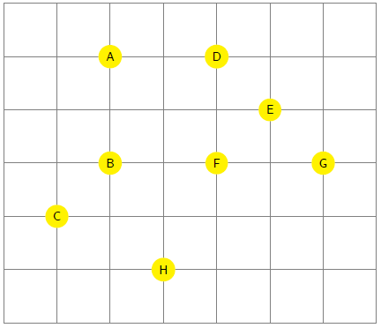
Cheapest Insertion Example

Slide 23
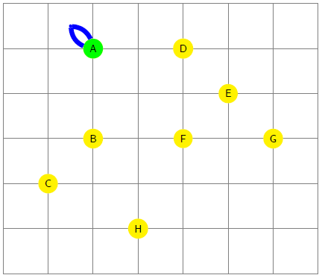
Cheapest Insertion Example
Start at a random node. Here we start at A

Slide 24
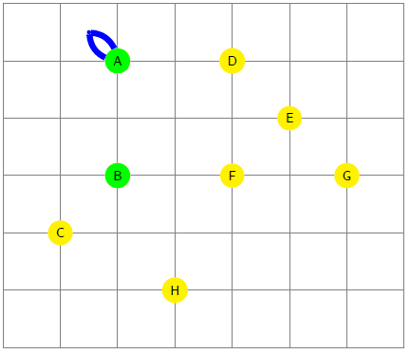
Cheapest Insertion Example
Choose any node not in tour such that we can insert that node at minimal cost

Slide 25
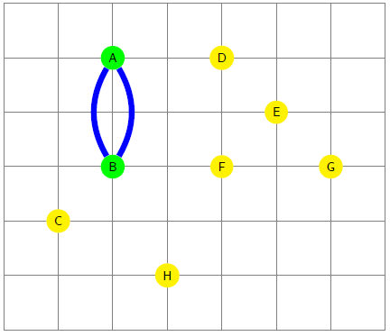
Cheapest Insertion Example

Slide 26
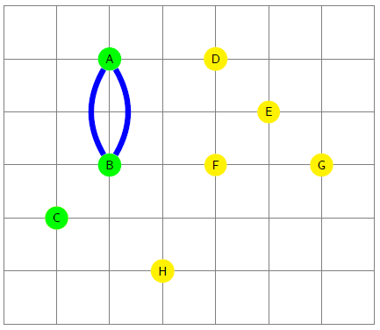
Cheapest Insertion Example
Choose any node not in tour such that we can insert that node at minimal cost

Slide 27
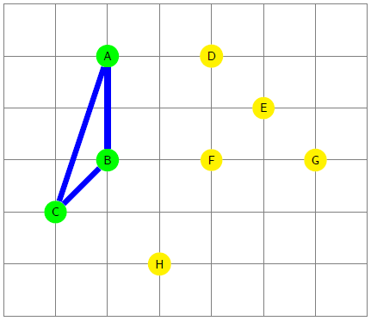
Cheapest Insertion Example

Slide 28
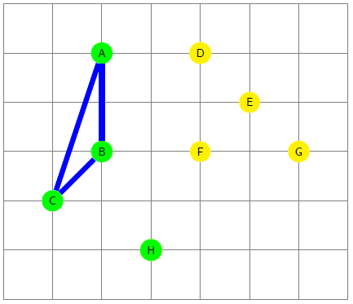
Cheapest Insertion Example
We now have an actual choice to make. Which arcs to delete? This is done by minimization of
c_{ik} + c_{kj} – c_{ij}

Slide 29
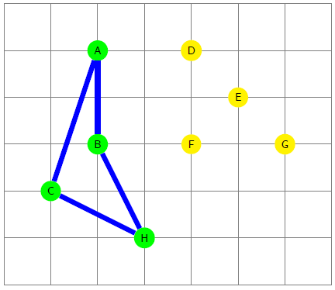
Cheapest Insertion Example
Delete edge such that we add next node as cheaply as possible.
Heuristic continues until all nodes are in tour.
Note: There is an error in this example. Given you start at A and choose to add B (arbitrarily over adding D) how should the example have proceeded?

Slide 30
Cheapest Insertion
At each step what is the neighborhood?
The set of all nodes not in tour
How do you choose an element from this set?
Choose the node k that minimizes c_{ik} + c_{kj} – c_{ij} for any (i ,j) currently in the tour.

Slide 31
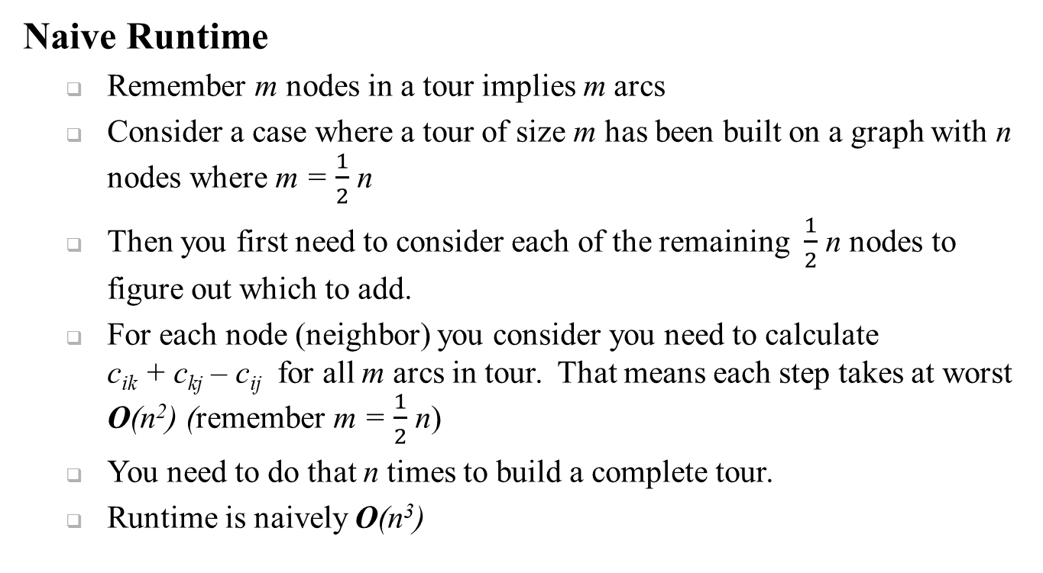
Cheapest Insertion
Naive Runtime
Remember m nodes in a tour implies m arcs
Consider a case where a tour of size m has been built on a graph with n nodes where m = $\frac{1}{2}$ n
Then you first need to consider each of the remaining $\frac{1}{2}$ n nodes to figure out which to add.
For each node (neighbor) you consider you need to calculate c_{ik} + c_{kj} – c_{ij} for all m arcs in tour. That means each step takes at worst O(n²) (remember m = $\frac{1}{2}$ n)
You need to do that n times to build a complete tour.
Runtime is naively O(n³)

Slide 32
Cheapest Insertion
Advantages?
Given a connected graph you are guaranteed a feasible tour
Easy to understand
Disadvantages?
Harder to implement then nearest neighbor
Can still provide bad solutions

Slide 33
Outline
Traveling Salesman Problem (TSP)
Construction Heuristics Overview
Examples of Construction Heuristics
Nearest Neighbor
Cheapest Insertion
Farthest Insertion
Greedy for TSP
Minimum Spanning Tree - Greedy Algorithm
MST for TSP - Greedy Heuristic
Christofides Algorithm

Slide 34
Farthest Insertion for TSP
Start with a single city (node) i and add it to the tour T.
If all cities are not included in the tour T, select the “furthest” city k not in T to be inserted.
Delete (i,j) and insert (i,k) and (k,j).
Return to Step 2.
The idea behind this insertion heuristic is to select k such that it is the farthest away from any node in the current tour.
However, when inserting k, we insert it in the cheapest way possible such that we minimize:
c_{ik} + c_{kj} - c_{ij}

Slide 35
Farthest Insertion for TSP
Why Furthest?
Idea is that we visit all the cities eventually… might as well minimize worst case situations
Advantages?
Given a connected graph you are guaranteed a feasible tour
Easy(ish) to understand
Disadvantages?
Harder to implement then nearest neighbor
Can still provide bad solutions

Slide 36
Farthest Insertion Example

Slide 37
Farthest Insertion Example
1) Choose a starting node
A

Slide 38
Farthest Insertion Example
2) Find node farthest away from any node in subtour
A
G

Slide 39
Farthest Insertion Example
3) Add node to tour in cheapest way
A
G

Slide 40
Farthest Insertion Example
2) Find node farthest away from any node in subtour
A
G
H

Slide 41
Farthest Insertion Example
3) Add node to tour in cheapest way
A
G
H

Slide 42
Farthest Insertion Example
2) Find node farthest away from any node in subtour
A
G
C
H

Slide 43
Farthest Insertion Example
3) Add node to tour in cheapest way
A
G
C
H

Slide 44
Farthest Insertion Example
A
D
E
B
F
G
C
H

Slide 45
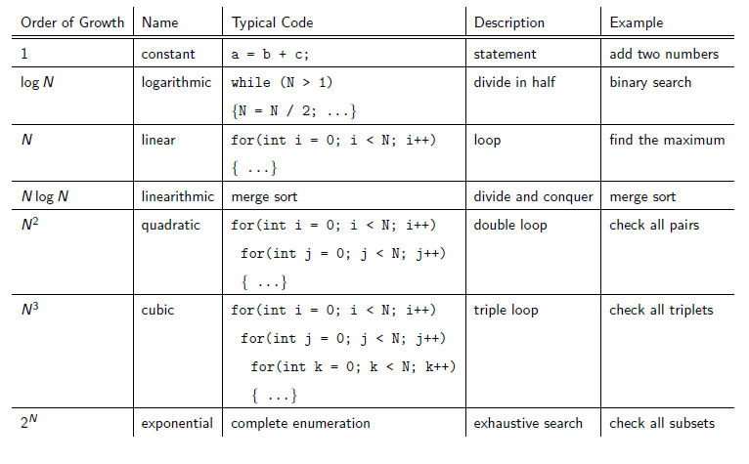
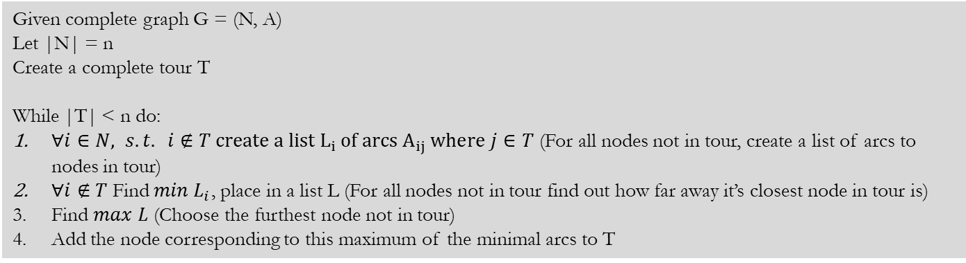
Farthest Insertion Naive Runtime
What if I asked you to estimate the Big O runtime for furthest insertion?
Consider Pseudocode and let’s add runtimes
Given complete graph G = (N, A)
Let |N| = n
Create a complete tour T
While |T| < n do:
$∀i∈N, s.t. i∉T create a list L_{i} of arcs A_{ij} where j∈T$ (For all nodes not in tour, create a list of arcs to nodes in tour)
$∀i∉T$Find$min L_{i}$, place in a list L (For all nodes not in tour find out how far away it’s closest node in tour is)
Find $max L$ (Choose the furthest node not in tour)
Add the node corresponding to this maximum of the minimal arcs to T
What are associated runtimes?
Worst case there is n/2 nodes in T and for every node in T we look at n/2 nodes not in T -> O(n) But we must do this for all n/2 nodes in T thus this step is O(n²)
We must find the minimum element for all lists. Finding a single minimum is O(n), but we must do this at worst n-1 times so this step is O(n²)
We must find maximum of the list L, which has at worst n-1 elements -> O(n)
We must do all the above steps n times O(n)
O(n(n² + n² + n)) = O(2n³ + n²) = O(n³)

Slide 46
Outline
Traveling Salesman Problem (TSP)
Construction Heuristics Overview
Examples of Construction Heuristics
Nearest Neighbor
Cheapest Insertion
Farthest Insertion
Arc-Greedy for TSP
Minimum Spanning Tree - Greedy Algorithm
MST for TSP - Greedy Heuristic
Christofides Algorithm

Slide 47
Arc-Greedy Heuristic for TSP
Often confusingly just called ‘Greedy’ or ‘Multi-Fragment’
Iteratively add the least cost arc to the tour if;
Arc does not allow a node to have degree 3
No cycles are created, unless last arc.
Unlike all prior constructive heuristics this allows multiple fragments to grow independently
Advantages:
Speed
Easy to communicate
Disadvantages:
Sometimes fail on an incomplete graph.
Still can provide bad solutions.

Slide 48
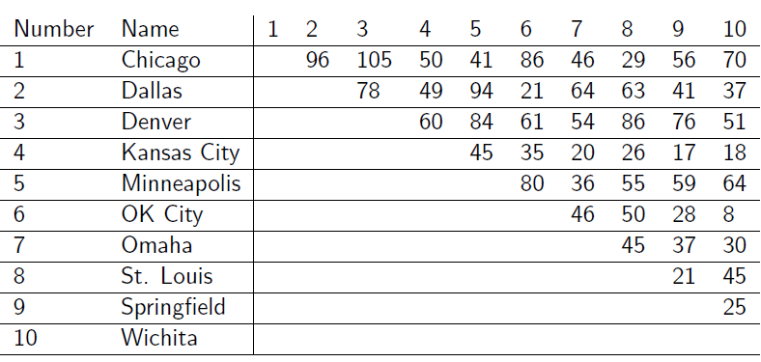
Arc-Greedy Heuristic for TSP
Use Arc-Greedy Heuristic for TSP to find a tour

Slide 49
Arc-Greedy Heuristic for TSP

Slide 50
Arc-Greedy Heuristic for TSP
At each iteration what are the elements of the neighborhood?
The set of arcs whose addition does not cause a node to have degree 3 or higher and do not form a premature subtour
How do you choose from this set?
Shortest arc

Slide 51
Arc-Greedy Heuristic for TSP
Coding the Arc-Greedy Heuristic
Its “easy” to verify that the addition of an arc to the partial tour does not violate node degree constraint
O(n²)
Much harder to ensure adding an arc will not create a subtour
Bentley proposes a method
Track the heads and tails of all fragments and ensure the head and tail of the same fragment do not connect
Exhaustive loop
After each addition you run through all arcs in associated fragment and ensure you do not return to start in under |V| steps
Jackovich, et al propose a way
Greedy Tracker updates a matrix of illegal arcs which would form subtours

Slide 52
Outline
Traveling Salesman Problem (TSP)
Construction Heuristics Overview
Examples of Construction Heuristics
Nearest Neighbor
Cheapest Insertion
Farthest Insertion
Greedy for TSP
Prims Algorithm for Minimum Spanning Tree
MST for TSP - Greedy Heuristic
Christofides Algorithm

Slide 53
Minimum Spanning Tree
Definition: A spanning tree T of a graph G is a connected acyclic subgraph that spans all nodes of G.
Given an undirected graph G = (N, A) with n = |N| nodes and m = |A| arcs and with a length or cost c_{ij} associated with each arc (i , j) ∈ A, we wish to find a spanning tree, called a minimum spanning tree, that has the smallest total cost (or length) of its constituent arcs, measured as the sum of costs of the arcs in the spanning tree.
Ahuja, Magnanti, Orlin 1993.

Slide 54

Prim's Algorithm
Constructive algorithm – (it is exact for MST)
Add all nodes to set $\overline{S}$ := set of unvisited nodes.
Select the least cost arc (i , j ) in $\overline{S}$.
Add nodes i and j to set S := set of visited nodes.
Iteratively add the least cost arc (i , j) to the Spanning Tree such that i ∈ S and j ∈ $\overline{S}$.

Slide 55
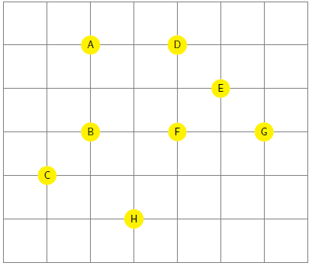
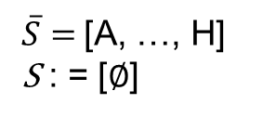
Example of Prim's Algorithm
1. Add all nodes to set $\overline{S}$ := set of unvisited nodes
$\overline{S}=$[A, …, H]
S : = [$∅$]
Assume fully connected graph G

Slide 56
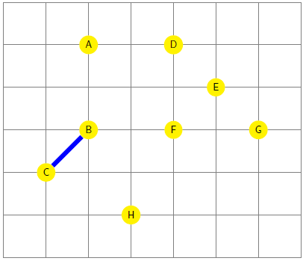
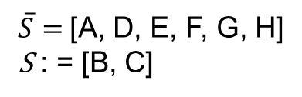

Example of Prim's Algorithm
2. Select the least cost arc (i , j ) in $\overline{S}$.
3. Add nodes i and j to set S := set of visited nodes.
$\overline{S}=$[A, D, E, F, G, H]
S : = [B, C]

Slide 57
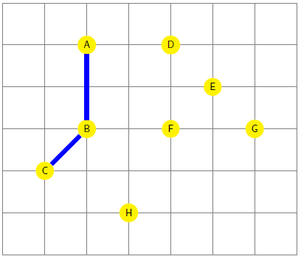
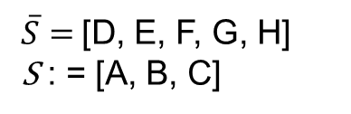
Example of Prim's Algorithm
4. Iteratively add the least cost arc (i , j) to the Spanning Tree such that i ∈ S and j ∈ $\overline{S}$.
$\overline{S}=$[D, E, F, G, H]
S : = [A, B, C]

Slide 58
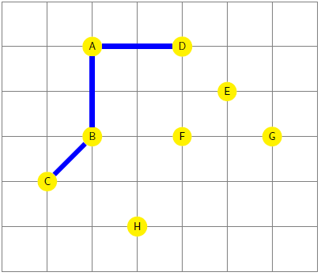
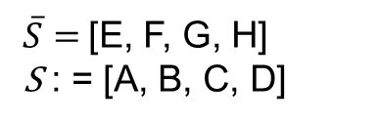
Example of Prim's Algorithm
$\overline{S}=$[E, F, G, H]
S : = [A, B, C, D]

Slide 59
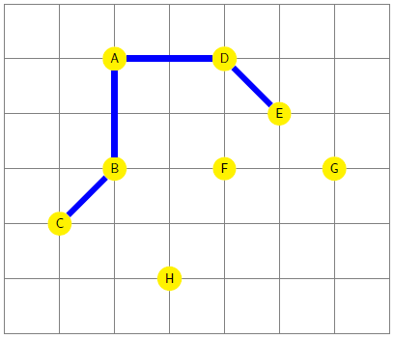
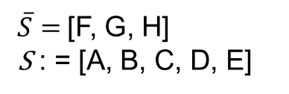
Example of Prim's Algorithm
$\overline{S}=$[F, G, H]
S : = [A, B, C, D, E]

Slide 60
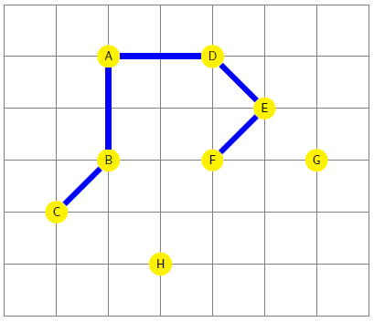
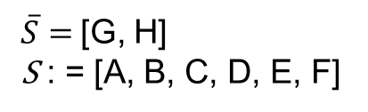
Example of Prim's Algorithm
$\overline{S}=$[G, H]
S : = [A, B, C, D, E, F]

Slide 61
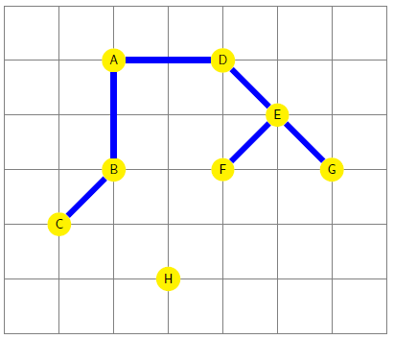
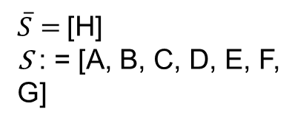
Example of Prim's Algorithm
$\overline{S}=$[H]
S : = [A, B, C, D, E, F, G]

Slide 62
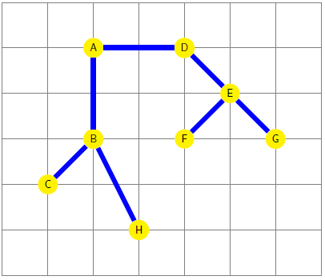
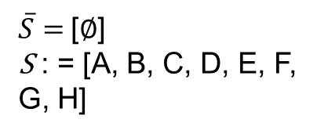
Example of Prim's Algorithm
$\overline{S}=$[$∅$]
S : = [A, B, C, D, E, F, G, H]

Slide 63
Outline
Traveling Salesman Problem (TSP)
Construction Heuristics Overview
Examples of Construction Heuristics
Nearest Neighbor
Cheapest Insertion
Farthest Insertion
Greedy for TSP
Minimum Spanning Tree - Greedy Algorithm
MST for TSP - Greedy Heuristic
Christofides Algorithm

Slide 64
MST for TSP
How can you use the MST of a graph to help solve the TSP?

Slide 65
Background Information
A tree traversal is a specific order in which to trace the nodes of a tree.
A pre-order walk of a tree visits root, left, right.

Slide 66
Pre-order Walk
Pre-Order: A - B - C - H - D - E - F - G

Slide 67
MST for TSP
One constructive heuristic using MST for TSP is as follows:
Solve for the MST on G.
Create a list of nodes based on a pre-order walk of the MST.
Create a tour by visiting the nodes in the pre-order walk list and returning to the start.

Slide 68
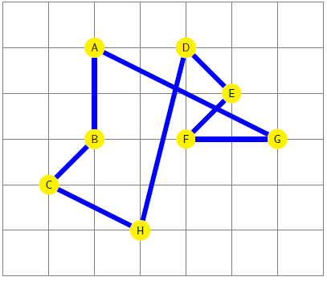
MST for TSP
Pre-Order: A - B - C - H - D - E - F - G

Slide 69
Outline
Traveling Salesman Problem (TSP)
Construction Heuristics Overview
Examples of Construction Heuristics
Nearest Neighbor
Cheapest Insertion
Farthest Insertion
Greedy for TSP
Minimum Spanning Tree - Greedy Algorithm
MST for TSP - Greedy Heuristic
Christofides Algorithm

Slide 70
Background Information Matching
Given an undirected graph G, a matching M is a set of arcs, such that no two share a node.
A perfect matching is a matching which matches (covers) all nodes in the graph.
A minimum cost perfect matching is a perfect matching with minimum cost.

Slide 71
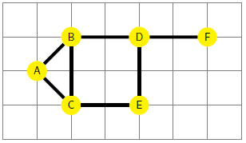
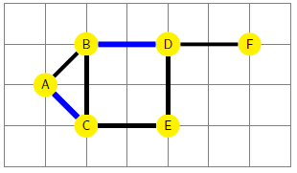
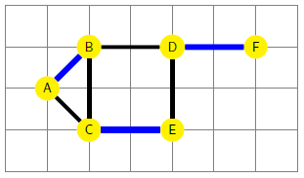
Background Information Matching
Graph G
A Matching on G
A Perfect Matching on G

Slide 72
Background Information Eulerian Tours
An Eulerian tour of a connected graph G = (N, A) is a cycle that traverses each arc of graph G exactly once, although it may visit a node more than once.
It is a generalization of the Konigsberg bridge problem
Euler showed that a connected graph has an Eulerian tour if and only if it has no node with odd degree.

Slide 73
Christofides Algorithm
Is it really an algorithm!?
Is it exact or provably approximate?
Christofides is a polynomial approximation algorithm for TSP.
Guarantees its solutions will be within a factor of 3/2 of the optimal solution length.
Theoretically interesting, but practically inferior to numerous modern heuristics

Slide 74
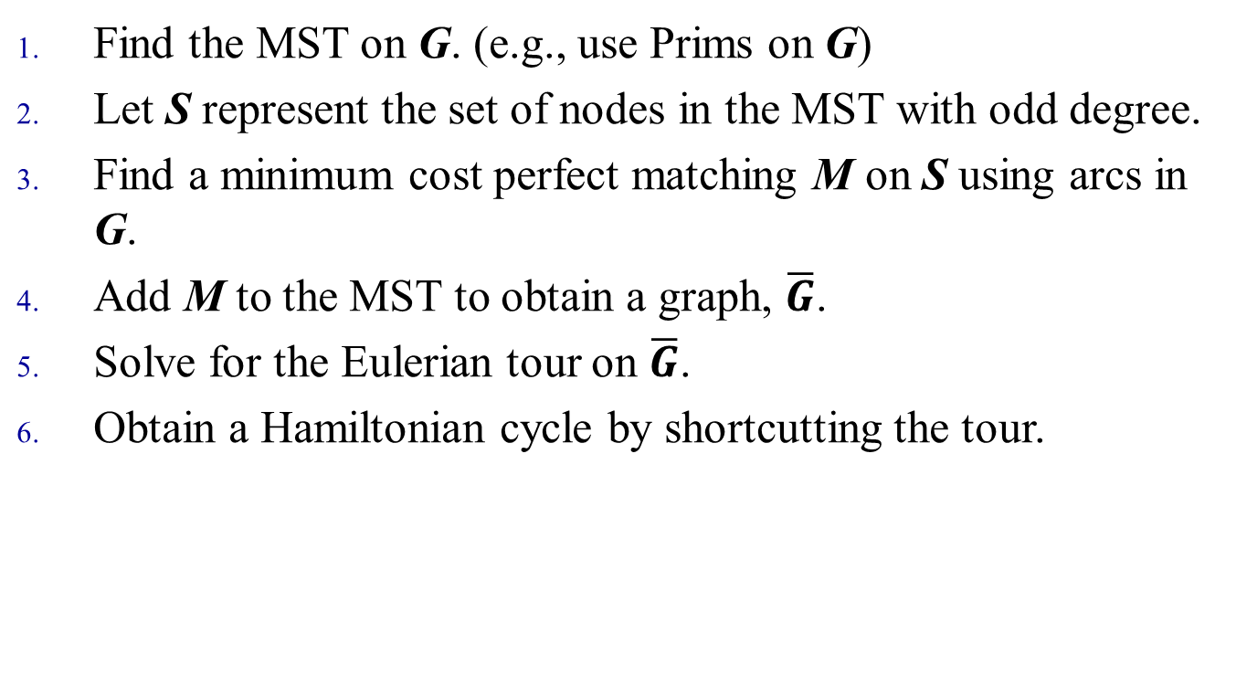
Christofides Algorithm
Find the MST on G. (e.g., use Prims on G)
Let S represent the set of nodes in the MST with odd degree.
Find a minimum cost perfect matching M on S using arcs in G.
Add M to the MST to obtain a graph, $\overline{G}$.
Solve for the Eulerian tour on $\overline{G}$.
Obtain a Hamiltonian cycle by shortcutting the tour.

Slide 75
Example of Christofides Algorithm: Step 1: Find the MST on G
Given : Complete graph G
Use Prims Algorithm to find MST on G

Slide 76
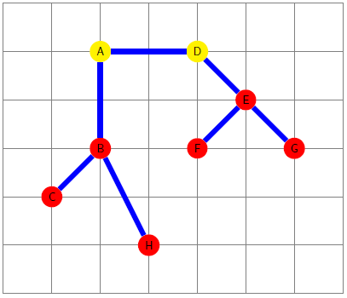
Example of Christofides Algorithm: Step 2: Let S be the nodes in the MST with odd degree
Find nodes with odd degree (colored red) Add these to set S

Slide 77
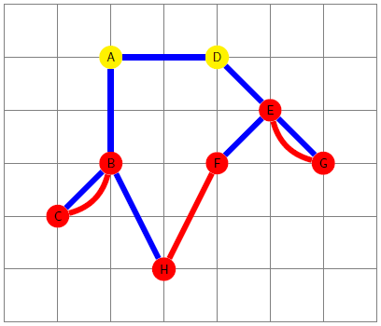
Example of Christofides Algorithm: Step 3
Find minimum cost perfect matching M on the subgraph of G induced by the nodes of S
Note: Subgraph of G induced by S := All nodes in S, and all arcs (i,j) in G where both i∈S and j∈S.

Slide 78
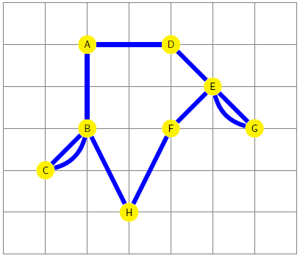
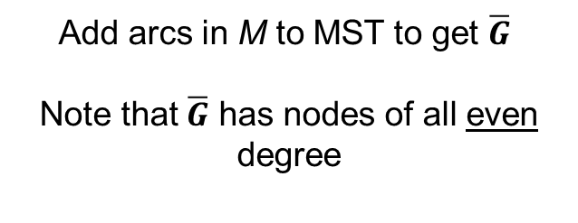
Example of Christofides Algorithm: Step 4
Add arcs in M to MST to get $\overline{G}$
Note that $\overline{G}$ has nodes of all even degree

Slide 79
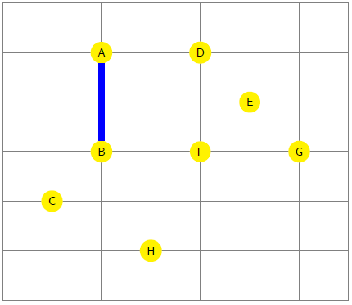
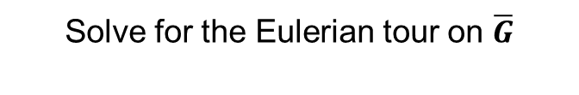
Example of Christofides Algorithm: Step 5
Add arcs in M to MST
Solve for the Eulerian tour on $\overline{G}$

Slide 80
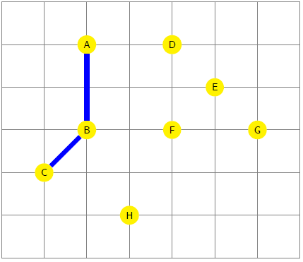
Example of Christofides Algorithm: Step 5
Add arcs in M to MST
Solve for the Eulerian tour on $\overline{G}$

Slide 81
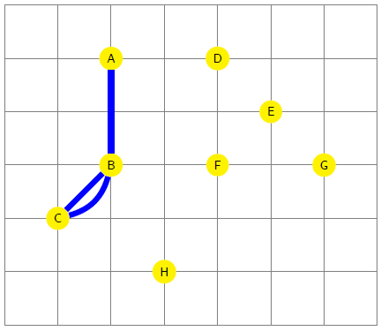
Example of Christofides Algorithm: Step 5
Add arcs in M to MST
Solve for the Eulerian tour on $\overline{G}$

Slide 82
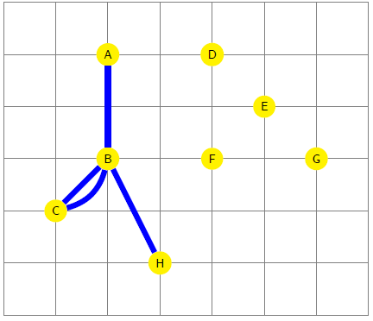
Example of Christofides Algorithm: Step 5
Add arcs in M to MST
Solve for the Eulerian tour on $\overline{G}$

Slide 83
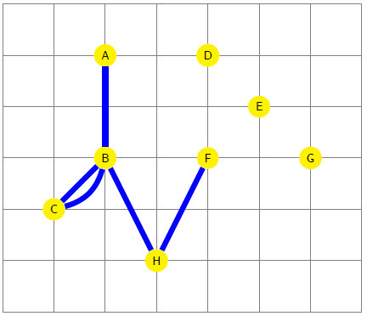
Example of Christofides Algorithm: Step 5
Add arcs in M to MST
Solve for the Eulerian tour on $\overline{G}$

Slide 84
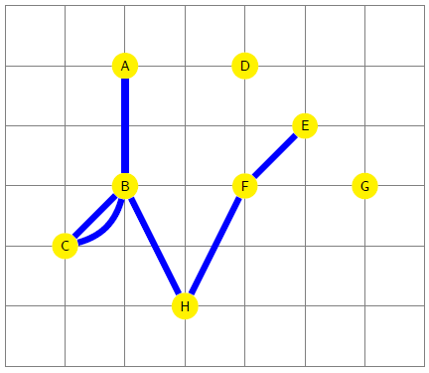
Example of Christofides Algorithm: Step 5
Add arcs in M to MST
Solve for the Eulerian tour on $\overline{G}$

Slide 85
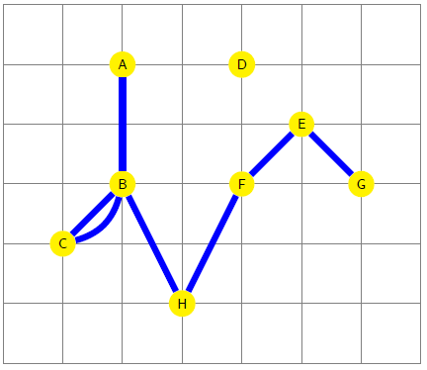
Example of Christofides Algorithm: Step 5
Add arcs in M to MST
Solve for the Eulerian tour on $\overline{G}$

Slide 86
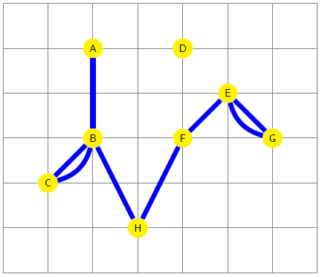
Example of Christofides Algorithm: Step 5
Add arcs in M to MST
Solve for the Eulerian tour on $\overline{G}$

Slide 87
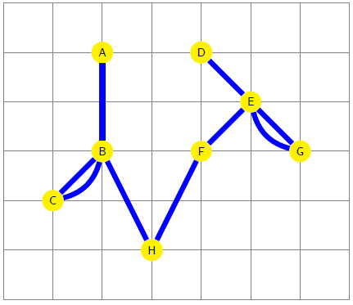
Example of Christofides Algorithm: Step 5
Add arcs in M to MST
Solve for the Eulerian tour on $\overline{G}$

Slide 88
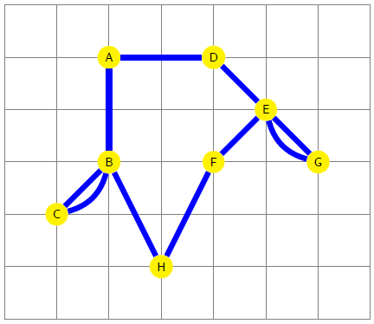
Example of Christofides Algorithm: Step 5
Add arcs in M to MST
Solve for the Eulerian tour on $\overline{G}$
Definition: Eulerian tour traverses each arc exactly once, can visit a node multiple times.

Slide 89
Example of Christofides Algorithm: Step 6
Add arcs in M to MST
Generate a Hamiltonian Cycle by “shortcutting” the Eulerian tour

Slide 90

Example of Christofides Algorithm: Step 6

Slide 91

Example of Christofides Algorithm: Step 6

Slide 92

Example of Christofides Algorithm: Step 6

Slide 93

Example of Christofides Algorithm: Step 6

Slide 94

Example of Christofides Algorithm: Step 6

Slide 95

Example of Christofides Algorithm: Step 6

Slide 96

Example of Christofides Algorithm: Step 6

Slide 97

Example of Christofides Algorithm: Step 6

